Slide 1
Deep learning Seminar
In Sierra BASE
RPN(loss),
BACKbone: resnet50,
Loss 수렴하게
fasterRCNN 내용추가
Inception-Resnet Code writing,
Collections of Human Dataset
2021. 08. 3 정재형

Slide 2
Inception Module이란 ConvNet을 깊이는 얕게, 연산layer는 넓게 쌓아 정확도는 올리면서 연산량을 줄일 수 있다. 대신 Parameter수는 매우 커지게되지만 가벼운 연산의 연속으로 결국 연산량은 줄어들게된다.
왼쪽이 기본 Inceptioon Module (7*7conv를 1*1+3*3+5*5로 나눔)을 통해 연산량을 줄인 모습이고
오른쪽이 1*1Conv를 통해 Channel도 줄인 Inception Module이다. (Channel을 줄임으로써 연산량 감소)
Inception V가 거듭될수록 발전하게되며 Inception V2에서는
Inception-Resnet : Concept of Inception, Residual Unit
1/10
Filter
Concatenation
Filter
Concatenation
3*3
Conv
5*5
Conv
1*1
Conv
1*1
Conv
1*1
Conv
3*3
Conv
5*5
Conv
3*3 max
Pooling
1*1
Conv
1*1
Conv
3*3 max
Pooling
Previous
Layer
Previous
Layer
Inception Module
Inception Module with dimension reductions
Inception Resnet : Stem + Inception(A,B,C) + Reduction(A,B)

Slide 3
Architecture : Stem
1/10
Stem : Basic Convolution network
Why use Stem? : In early Layer, Inception layer doesn’t have good affect.
3*3
Max
pool
1*1
Conv
3*3
Conv
Max
pool
(73*73*160)
(71*71*192)
(35*35*384)
Input
3*3
Conv
3*3
Conv
3*3
Conv
C
o
n
c
a
t
C
o
n
c
a
t
C
o
n
c
a
t
3*3
Conv
1*1
Conv
7*1
Conv
1*7
Conv
3*3
Conv
3*3
Conv
(299*299*3)
(149*149*32)
(147*147*32)
(147*147*64)

Slide 4
Architecture : Stem Codes
1/10
Stem : Basic Convolution network
Why use Stem? : In early Layer, Inception architecture doesn’t have good affect.

Slide 5
Architecture : Inception-A
1/10
ReLU
1*1 Conv
(384 Linear)
3*3 Conv
(64)
1*1 Conv
(32)
3*3 Conv
(32)
3*3 Conv
(48)
1*1 Conv
(32)
1*1 Conv
(32)
ReLU

Slide 6
Architecture : Inception-A Codes
1/10

Slide 7
Architecture : Inception-B
1/10
ReLU
1*1 Conv
(1154 Linear)
7*1 Conv
(192)
1*1 Conv
(192)
1*7 Conv
(160)
1*1 Conv
(128)
ReLU

Slide 8
Architecture : Inception-B Codes
1/10
Stem : Basic Convolution network
Why use Stem? : In early Layer, Inception architecture doesn’t have good affect.

Slide 9
Architecture : Inception-C
1/10
ReLU
1*1 Conv
(2048 Linear)
3*1 Conv
(256)
1*1 Conv
(192)
1*3 Conv
(224)
1*1 Conv
(192)
ReLU

Slide 10
Architecture : Inception-C Codes
1/10
Stem : Basic Convolution network
Why use Stem? : In early Layer, Inception architecture doesn’t have good affect.

Slide 11
Architecture : Reduction A & B
1/10
Filter
Concatenate
Filter
Concatenate
3*3 Conv
(256 stride 2 V)
3*3 Conv
(m stride 2 V)
3*3 Conv
(384 stride 2 V)
3*3 Conv
(256 stride 2 V)
3*3 Conv
(256)
3*3 Maxpool
(stride 2 V)
3*3 Conv
(n stride 2 V)
3*3 Conv
(I)
3*3 Maxpool
(stride 2 V)
1*1 Conv
(256)
1*1 Conv
(256)
3*3 Conv
(256)
3*3 Conv
(k)
Filter
Concatenate
Previous
Layer

Slide 12
Architecture : Reduction-A Codes
1/10
Stem : Basic Convolution network
Why use Stem? : In early Layer, Inception architecture doesn’t have good affect.

Slide 13
Architecture : Reduction-B Codes
1/10
Stem : Basic Convolution network
Why use Stem? : In early Layer, Inception architecture doesn’t have good affect.

Slide 14
Whole Inception-Resnet Architecture(same as V1 & V2)
1/10
Inception-resnet [A,B,C]
Input
Stem
IR
(A)
Reudction
A
IR
(B)
Reduction
B
IR
(C)
Avg
Pooling
Dropout
(keep 0.8)
Softmax
(299*299*3)
(35*35*256)
(35*35*384)
(17*17*1154)
(17*17*1154)
(8*8*2048)
(8*8*2048)
(2048)
(2048)
X5
X10
X5

Slide 15
Training Results : with Cifar10 Data
1/10
Stem : Basic Convolution network
Why use Stem? : In early Layer, Inception architecture doesn’t have good affect.

Slide 16
Training Results : with Cifar10 Data
1/10
Stem : Basic Convolution network
Why use Stem? : In early Layer, Inception architecture doesn’t have good affect.

Slide 17
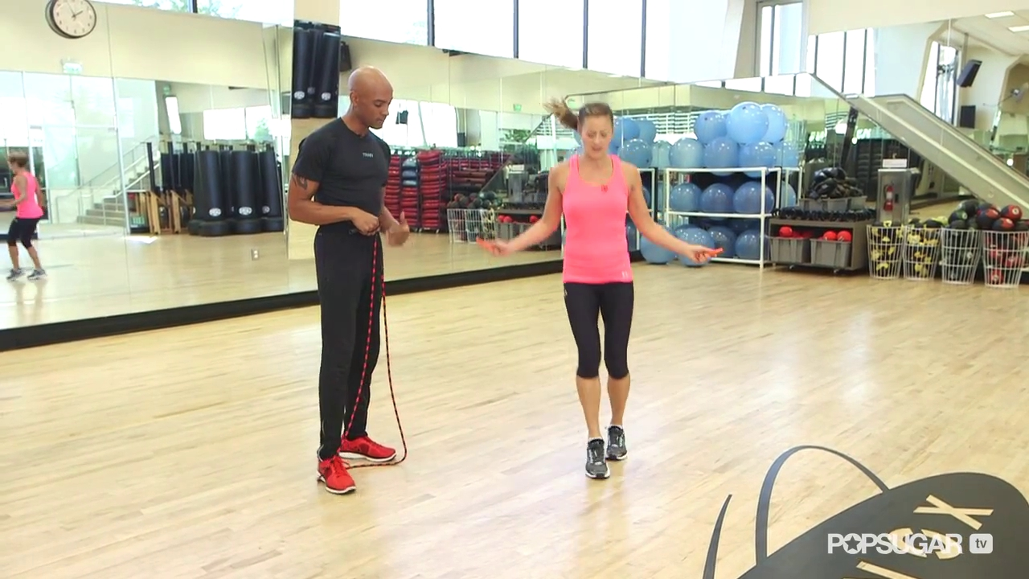
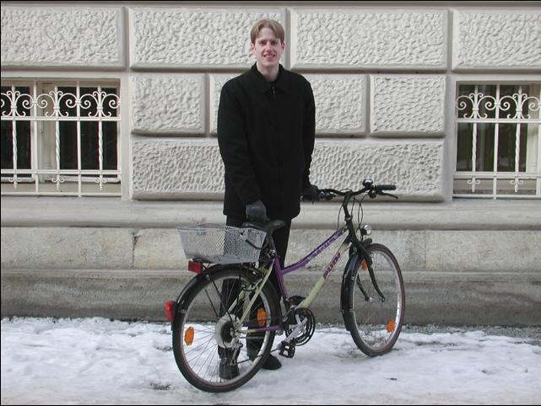
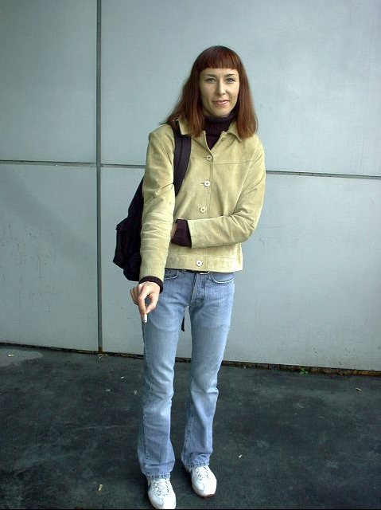
Human Dataset : MP2, INRIA
1/10
MP2 Human_Pose_Data
Data Feature : Mostly 1or2 people with specific pose.
Data Size : (Data : 12.9GB / Annot(.mat) 12.5MB / 25K images)
INRIA HumanData (Normal, with_Bike_set)
Data Feature : Casual People & People with bike Data Size : (Data 700MB / Annot X / 772 images),
(Data 193.5MB / Annot X / 210 images : with_BikeSet)

Slide 18
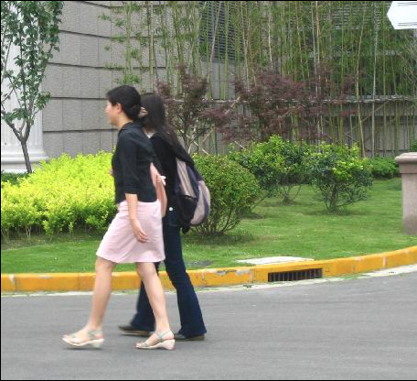
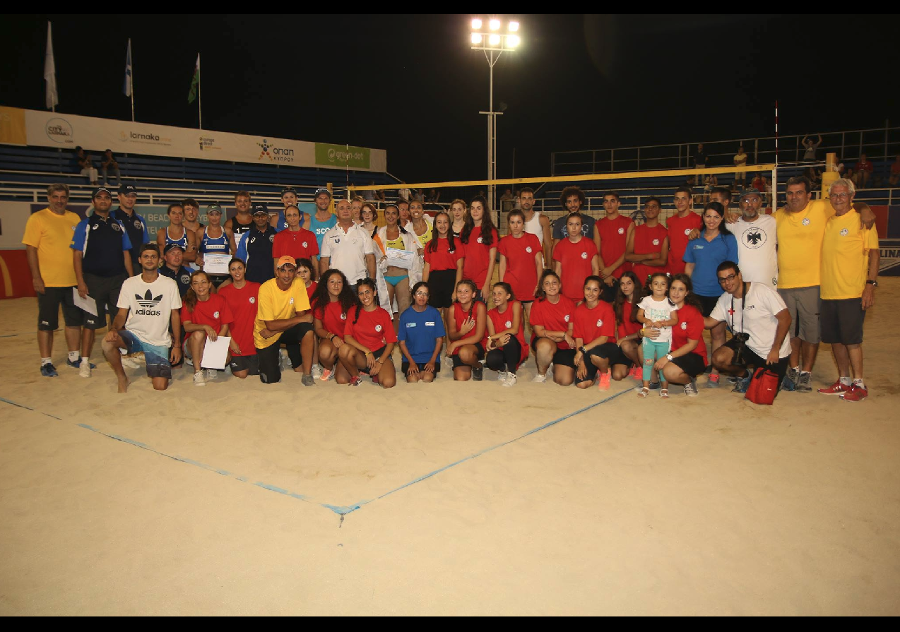
Human Dataset : PennFudanPed, CrowdHuman
1/10
PennFudanPed
Data Feature : Casual Pedestrians(most two or more) Data Size : (Data 53.2MB / Annot 170.6KB / 170 images)
CrowdHuman
Data Feature : Pedestrians(train, val, test) Data Size : (Data 8.6GB / Annot(format : odgt, 80.0MB / 15K images) Data Size(val) : (Data 2.6GB / Annot(format : odgt, 23.3MB / 4.37K images) Data Size(Test) : (Data 3.3GB / Annot X / 5K images)
Total Dataset : about 50K images
- MP2 : 25K
- INRIA : 1K
- PennFudanPed : 0.17K
- CrowdHUman : 24.37K (Train 15K + Val 4.37K + Test 5K)

Slide 19


References
9/10
Inception Resnet Models : https://norman3.github.io/papers/docs/google_inception.html
Human Dataset
MP2 : http://human-pose.mpi-inf.mpg.de/#download
INRIA : http://pascal.inrialpes.fr/data/human/
PennFudanPed : https://www.cis.upenn.edu/~jshi/ped_html/
CrowdHuman : http://www.crowdhuman.org/download.html

